Slide 1
Group Project
Week 3, Day 1

Slide 2
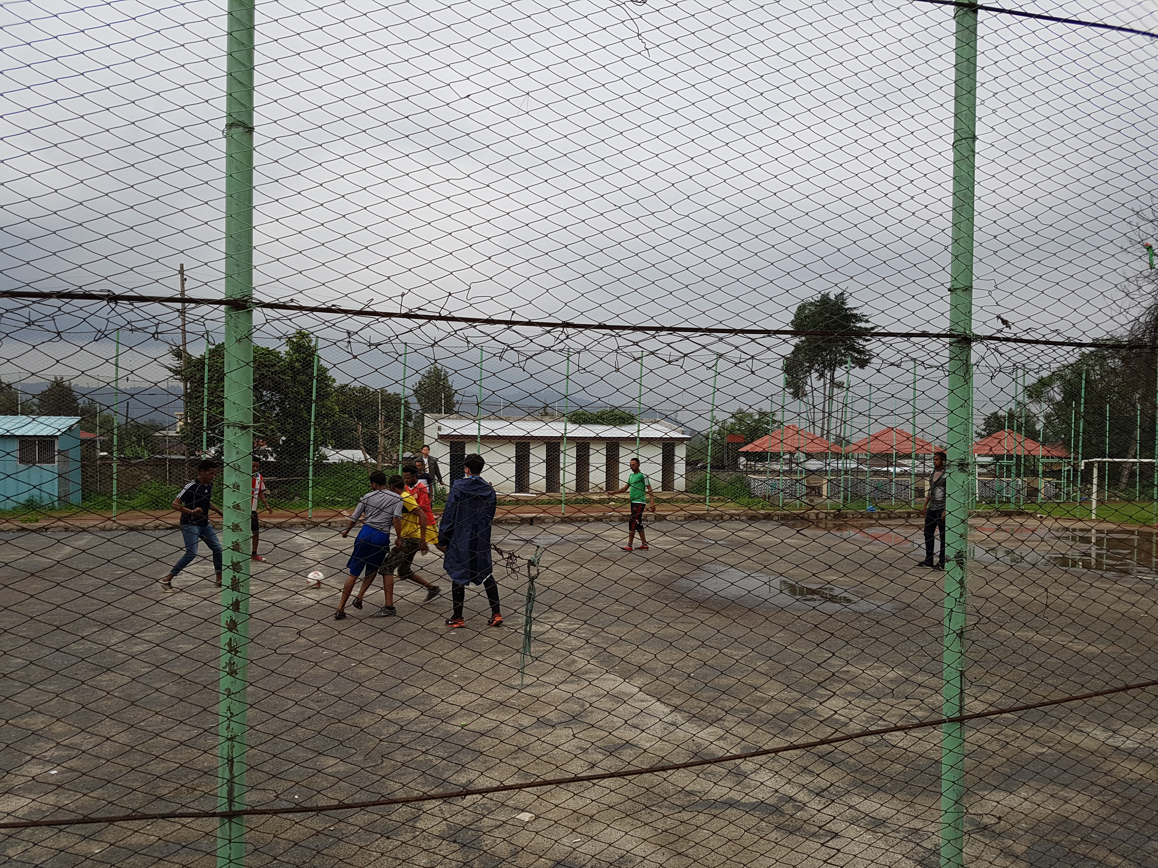
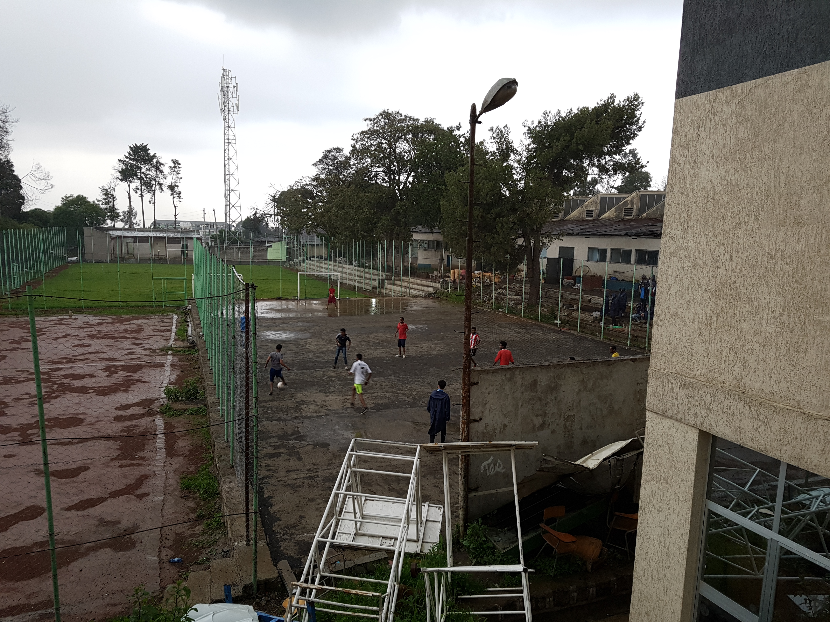
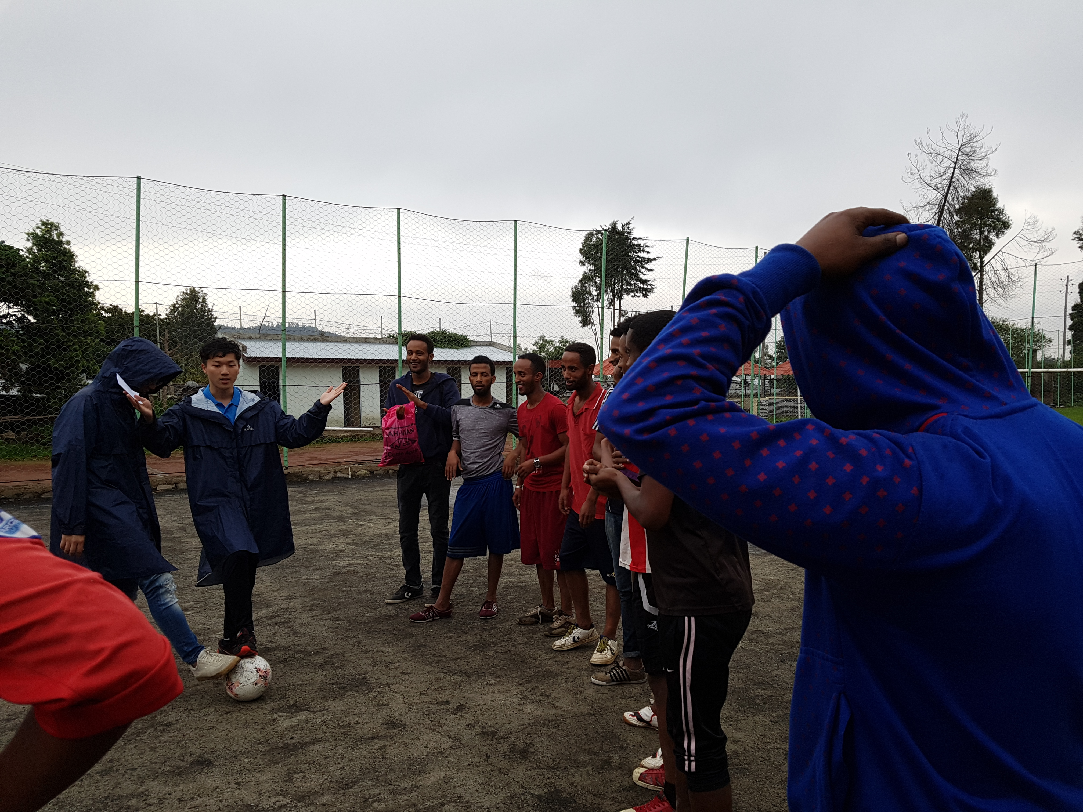
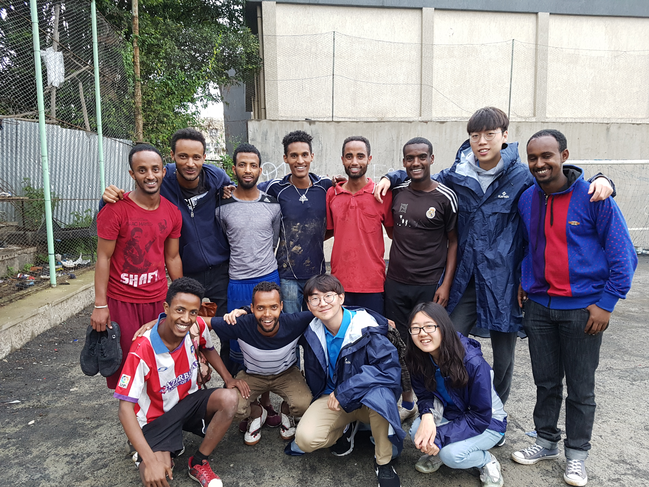
Football Tournament

Slide 3
Schedule for This Week
Day 1 - Brainstorming & Prototyping
Day 2 - UI Examples & Implementation
Day 3 - Implementation
Day 4 - User Test & Iteration
Day 5 - Presentation & Exam

Slide 4
What do we learn today?
Usability Issues
Ideation
Design Guidelines
Prototyping & Prototyping Test
Four Group Activities (no lab session today)

Slide 5
Group Project
Objective
Build a website that introduces and compares Ethiopia and Korea
Requirements
Two features that use JavaScript
One interesting feature that considers usability issues
Final Presentation
2 minute short presentation on your outcome

Slide 6
Usability Issues
(1/5)

Slide 7
Learnability
Intuitive
System Model = Mental Model
Easy to learn
Step by step
Straightforward
Simplicity

Slide 8
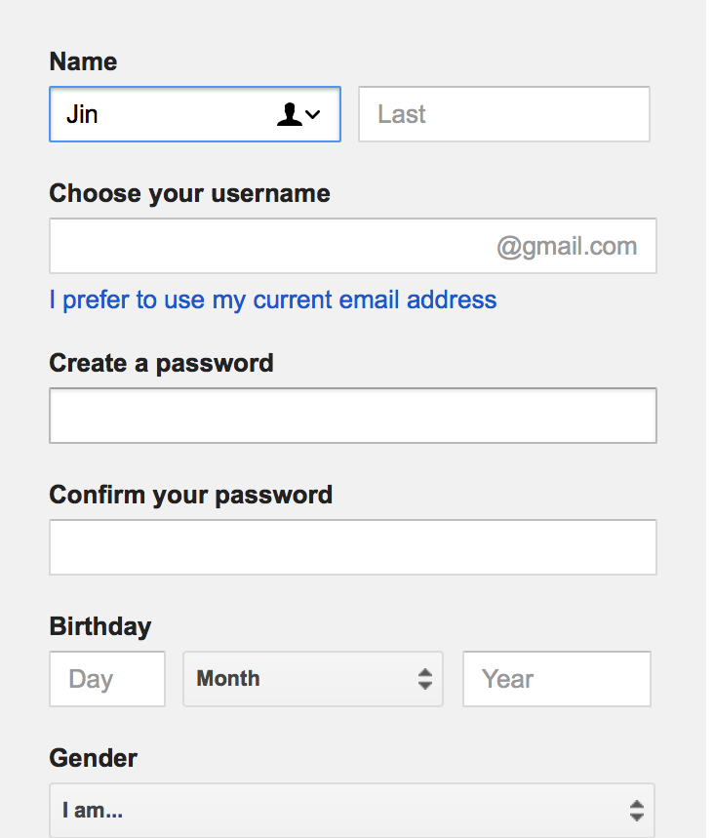
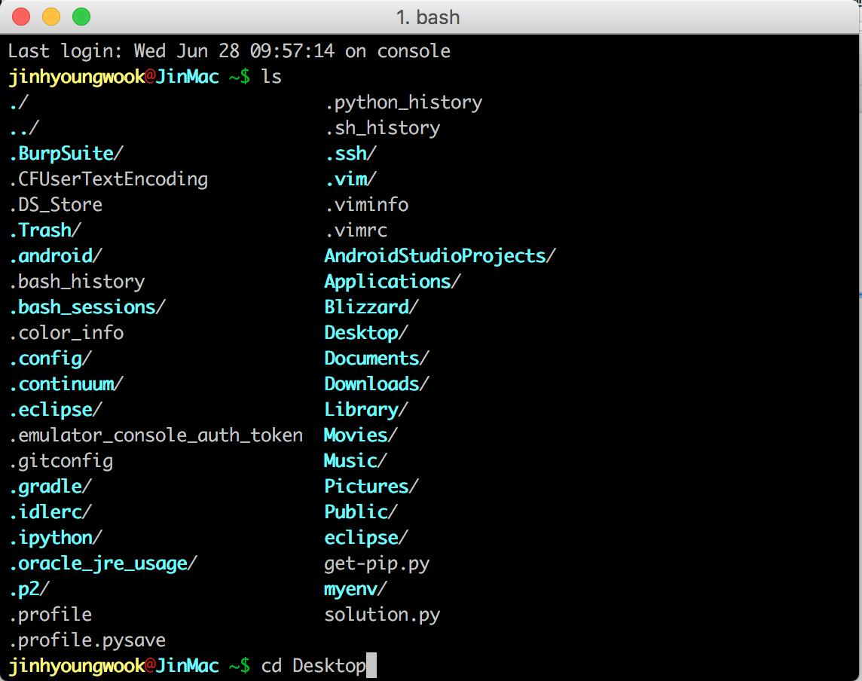
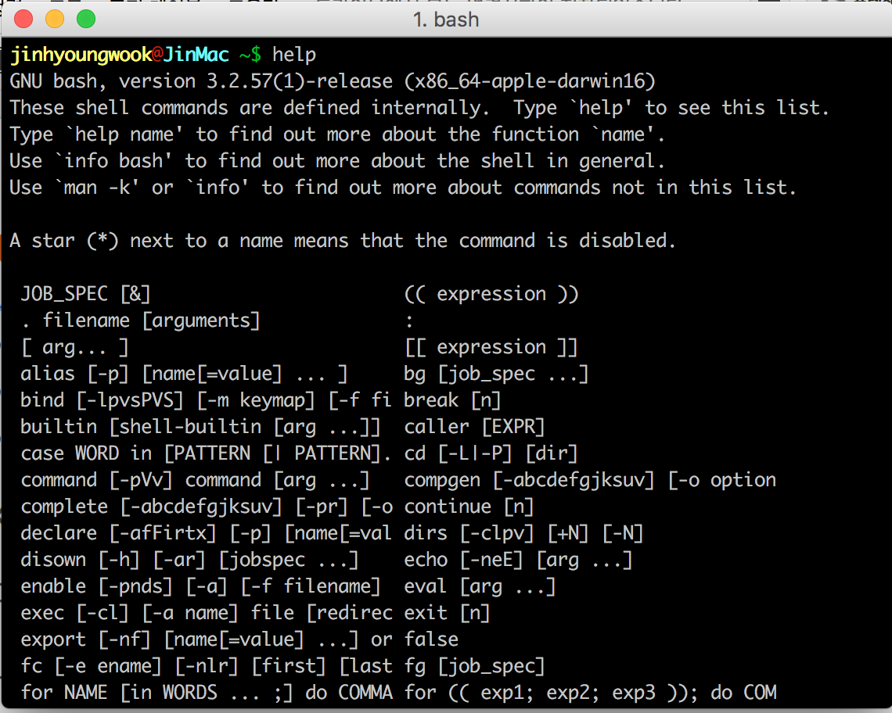
Learnability - Example
Command line languages v.s. Menus and forms
Intuitive?
Easy to learn?
Straightforward?

Slide 9
Efficiency
Less time to do a task
Shortcuts
Less time to do a set of tasks
Pointing & Steering

Slide 10
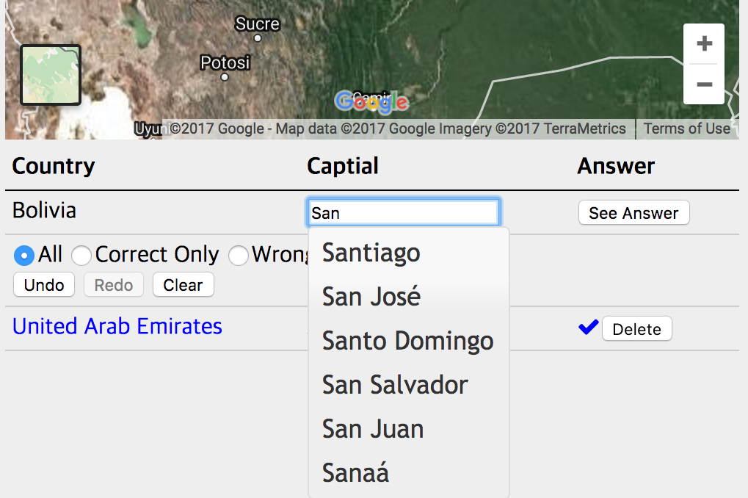
Efficiency - Example
Autocomplete

Slide 11
Safety
Easy to go back
Undo & Redo
Interaction styles
Prevent errors
Warnings
Restrictions

Slide 12
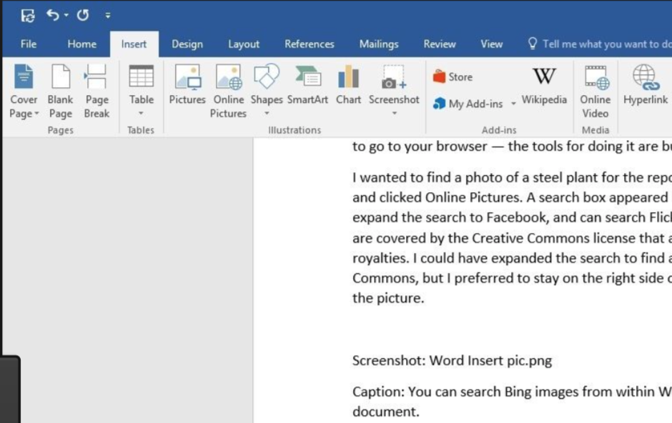
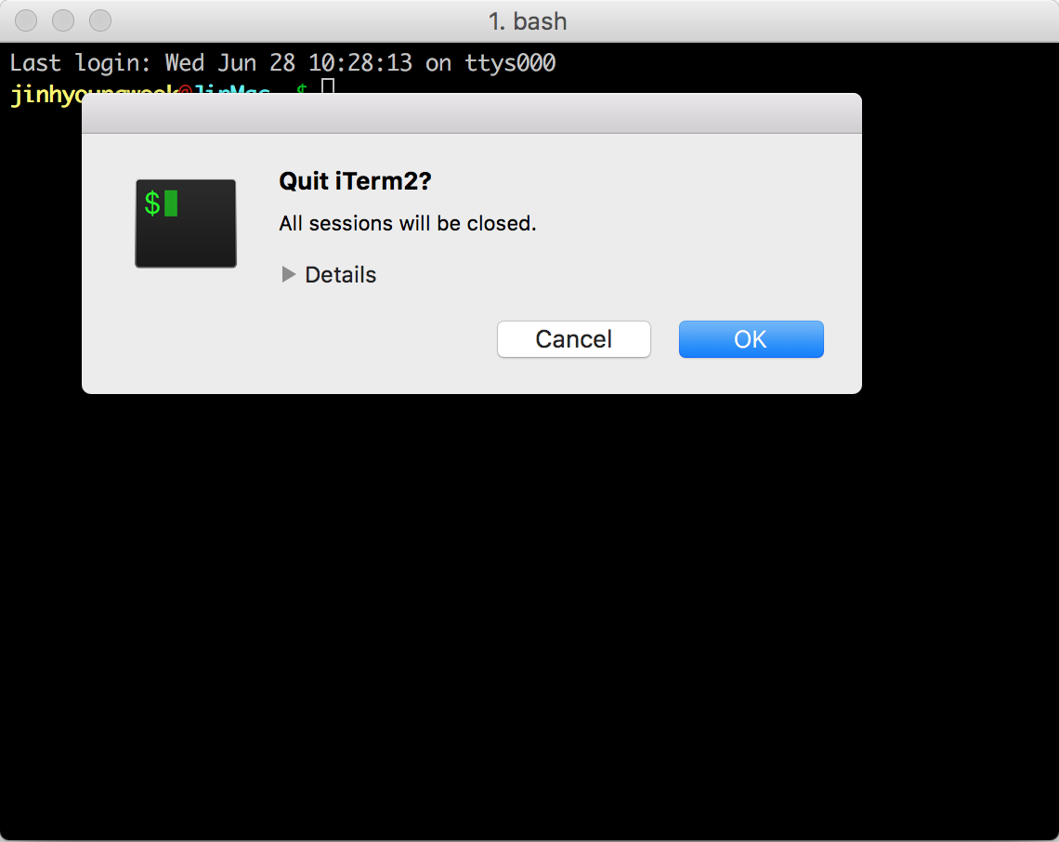
Safety - Example
Undo & Confirmation dialog

Slide 13
Ideation
(2/5)

Slide 14
Brainstorming
Key Principles
Defer judgement
Reach for quantity
Reduce Social Inhibition
Idea Generation
Increase Creativity

Slide 15
IDEO’s Rule
Be visual
Defer judgment
Encourage wild ideas
Build on the ideas of others
Go for quantity
One conversation at a time
Stay focused on the topic

Slide 16
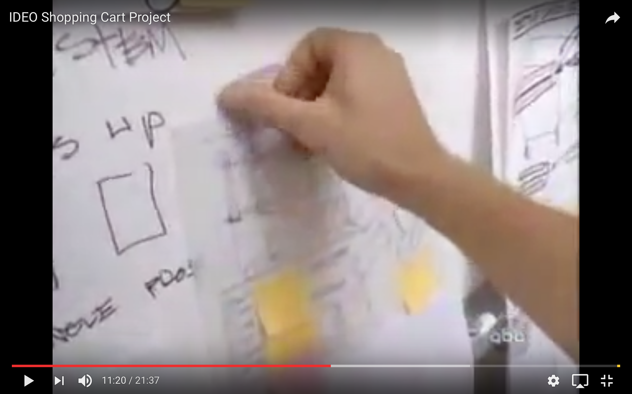
Video Break

Slide 17
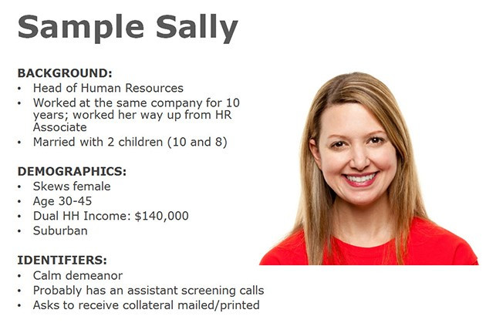
Persona
A model user that represents a user class
Abstraction of actual users’ behavior patterns
Build empathy and stay grounded

Slide 18
Core Tasks
Identify user’s goal
Followed by persona
Decompose into subtasks
Step by step subtasks
Abstraction
Be general, not specific

Slide 19
Group Activity 1 [5 min]
Brainstorm your basic ideas on your website
Set your persona & core tasks
e.g. nationality, age, gender, experty
Information to include
map?, demography?, national flag?
General layout of your website
sections?, image placement?, alignment?

Slide 20
Design Guidelines
(3/5)

Slide 21
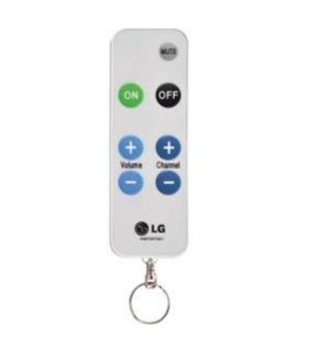
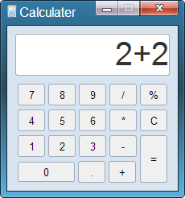
Simplicity - Reduction
Remove inessential features & functions

Slide 22
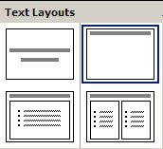
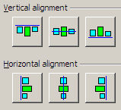
Simplicity - Regularity
Limit inessential variations & irregularity

Slide 23
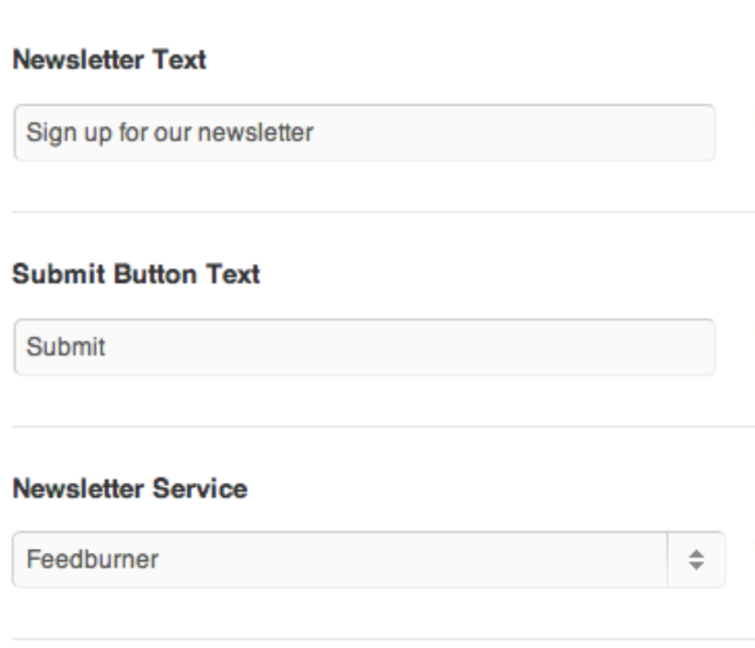
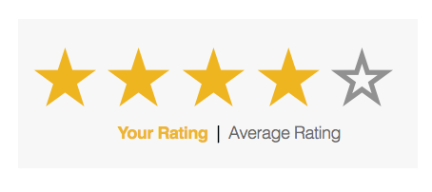
Simplicity - Double Duty
Combine functions into a feature

Slide 24
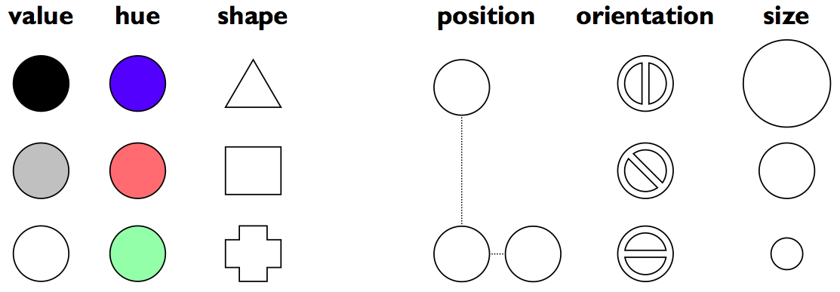
Visual contrast

Slide 25
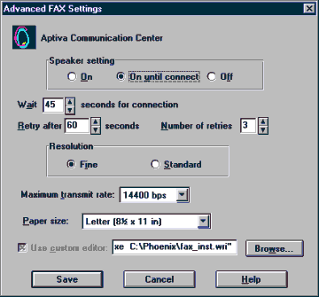
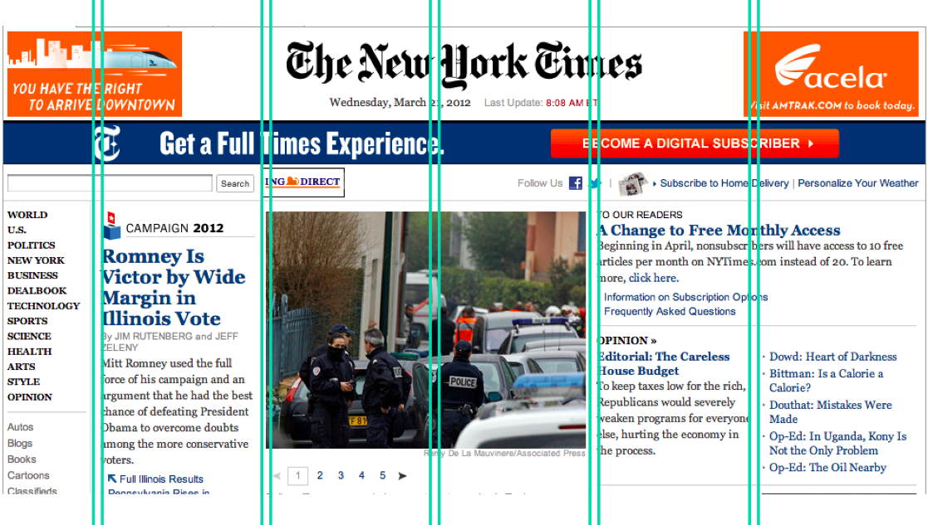
Alignment
Align labels left or right
Align text baselines
Organize information in columns

Slide 26
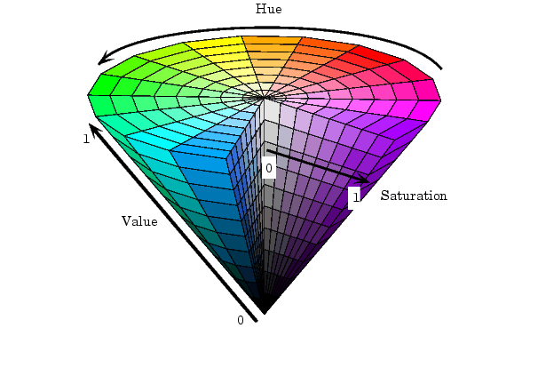
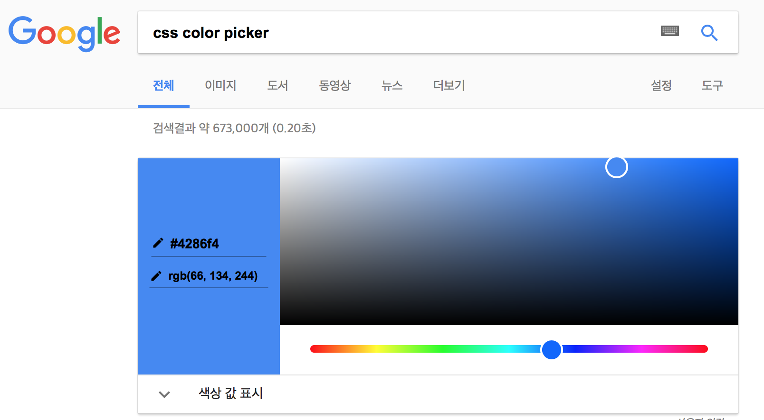
Color Model
value, hue, saturation

Slide 27
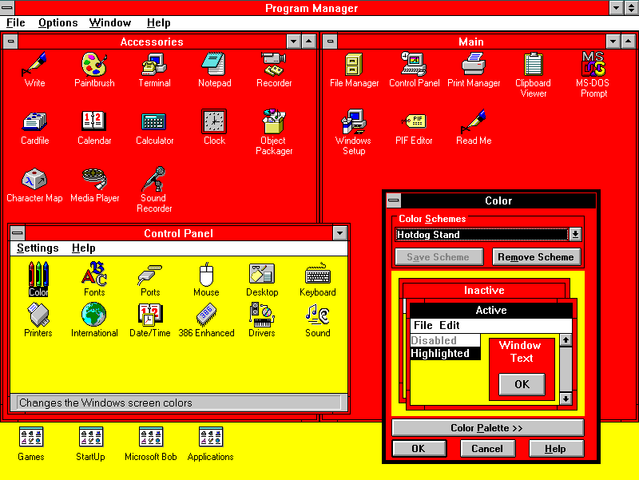
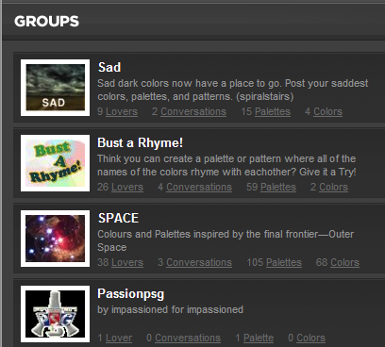
Background Color
Avoid saturated & low value colors

Slide 28
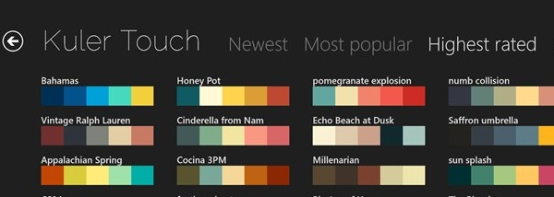
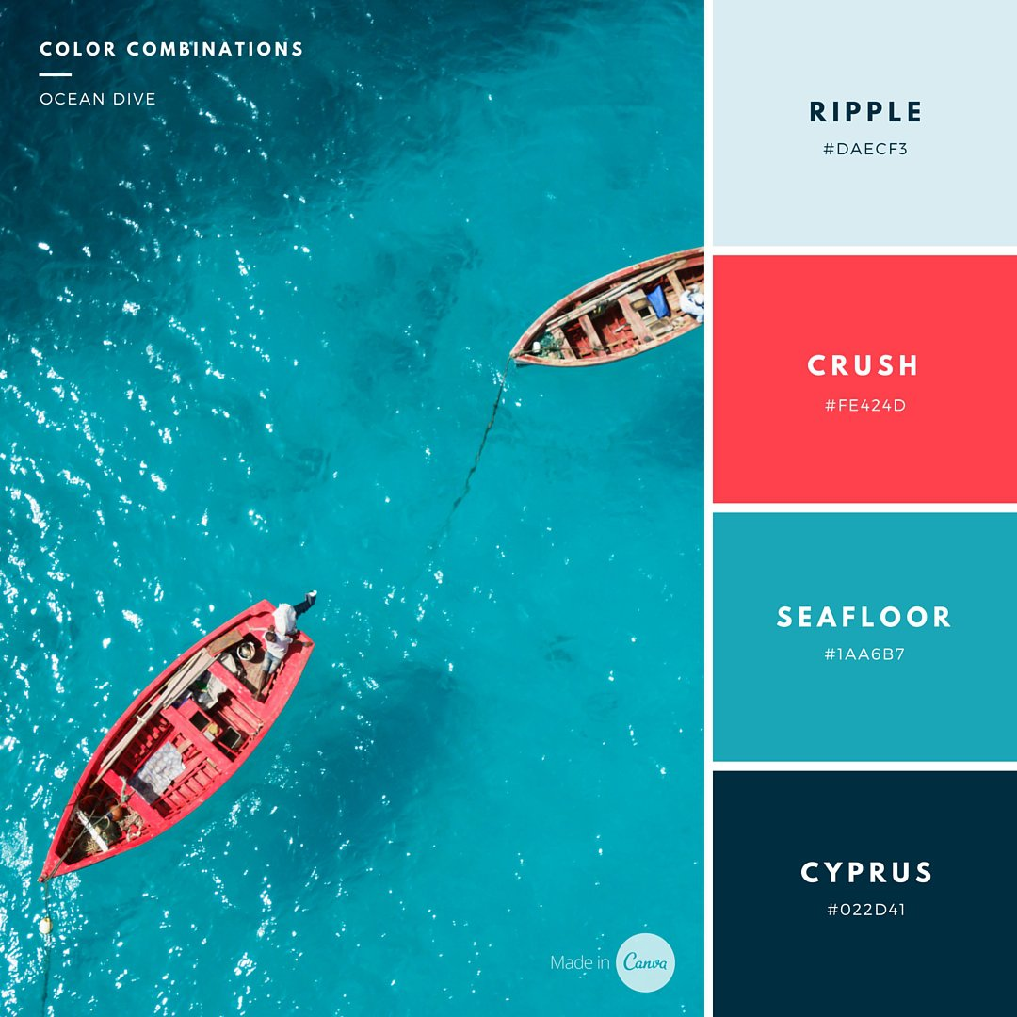
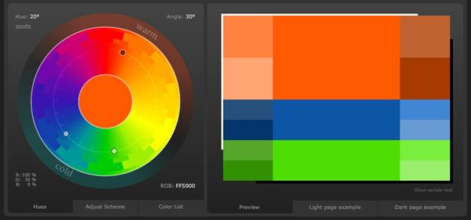
Color Scheme

Slide 29
Group Activity 2 [5 min]
Discuss about the ways to improve the readability of your website including:
Simplicity
Visual contrast
Background color
Color scheme

Slide 30
Prototyping
(4/5)

Slide 31
Why prototype?
Get feedback earlier, cheaper
Experiment with alternatives
Easier to change or throw away

Slide 32
Fidelity
Low, Mid, High
Cheaper, faster to build
More practical feedback

Slide 33
Feel and Look
Feel
Input method
Realistic task
pointing with hands v.s. pointing with a mouse
Look
Appearance
graphic design
Computer-drawn v.s. hand-drawn

Slide 34
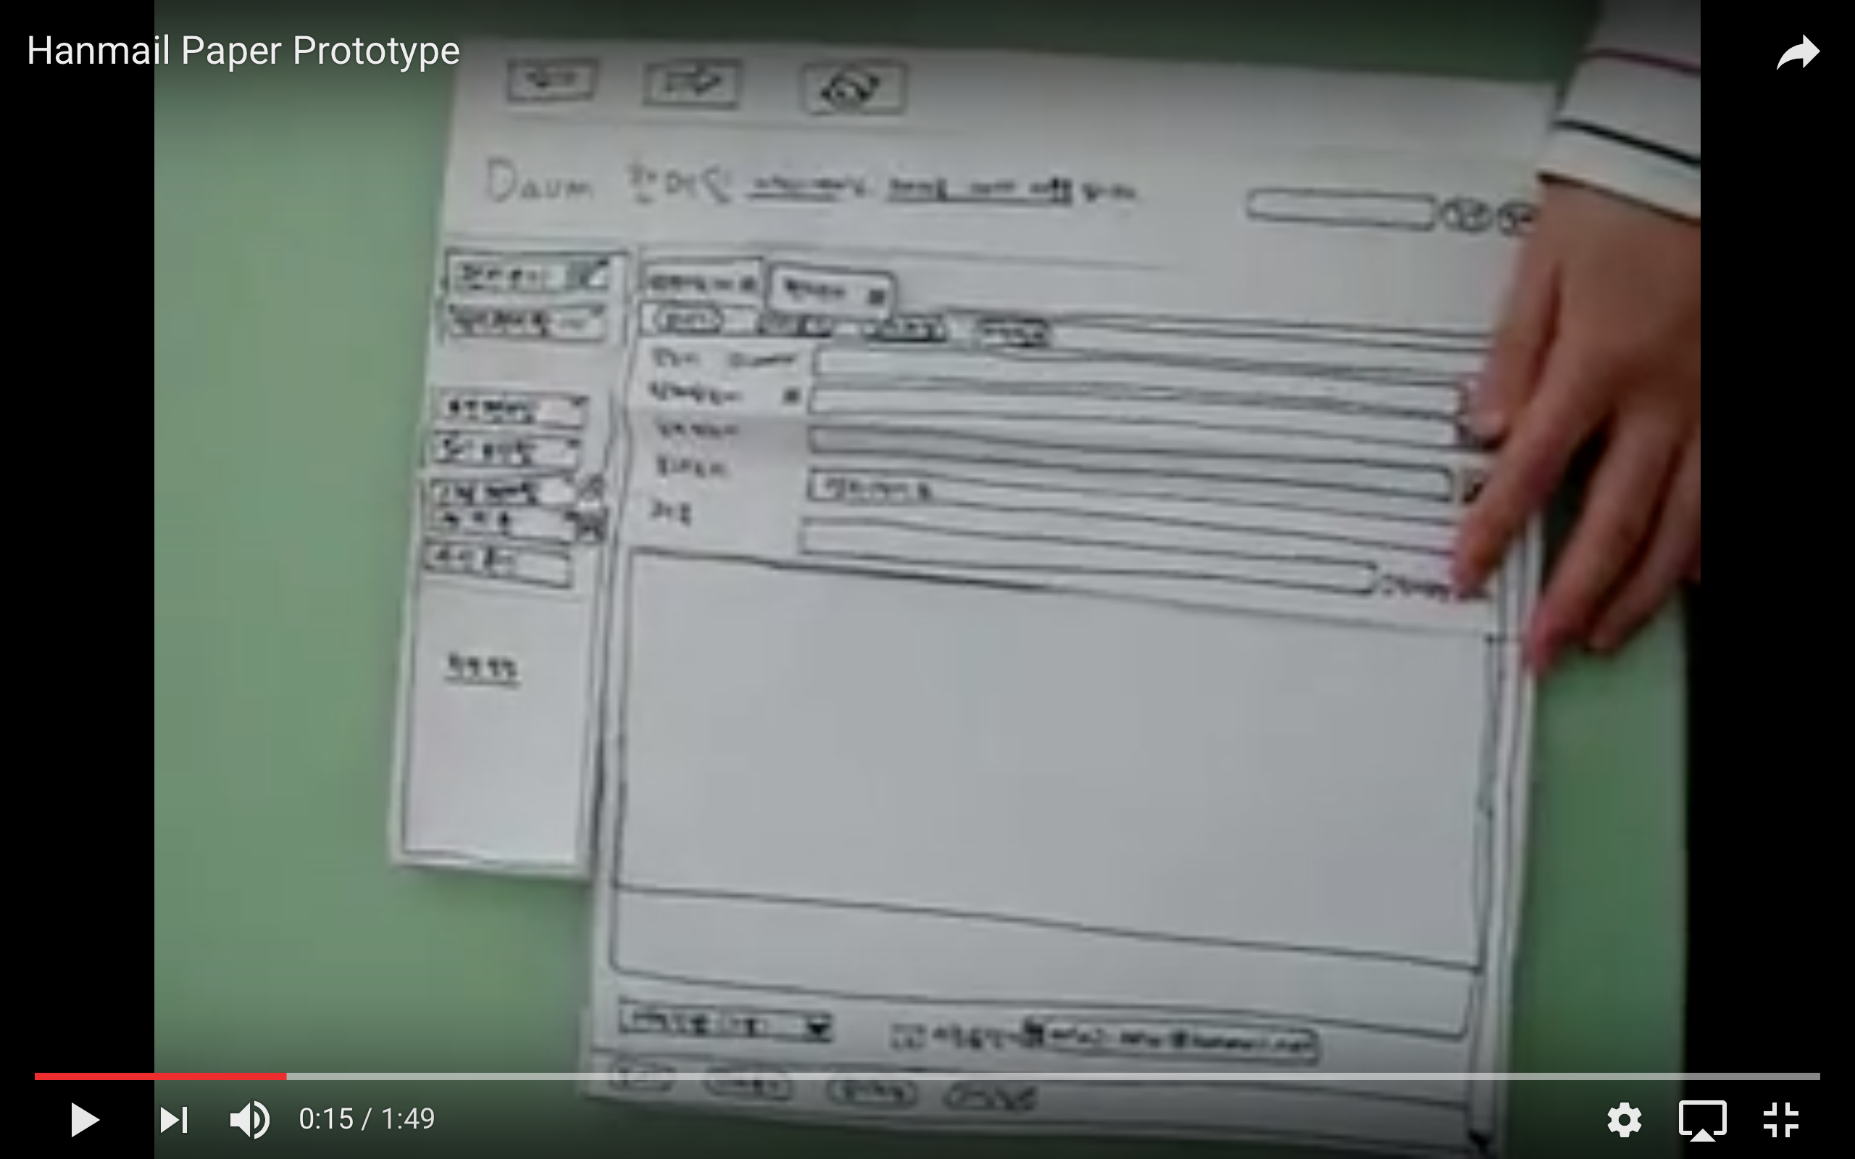
Video Break

Slide 35
Paper Prototype
Faster to build
Sketching is faster than programming
Easier to change
Easy to change even during a user test
Focuses attention on big picture
Save time from focusing on details
You can easily customize and test out your own creative design
Non-programmers can help
Only kindergarten skills are required

Slide 36
Tips for Good Prototypes
Make it larger
Make it monochrome
Keep paper pieces organized and safe

Slide 37
Group Activity 3 [10 min]
Please build your paper prototypes based on the ideas you already talked about

Slide 38
Prototype Test
(5/5)

Slide 39
Roles
Facilitator
Does the briefing
Provides tasks to test
Observer
Stay quiet
Take notes
Computer
Perform page changes
Be mechanical and consistent as possible

Slide 40
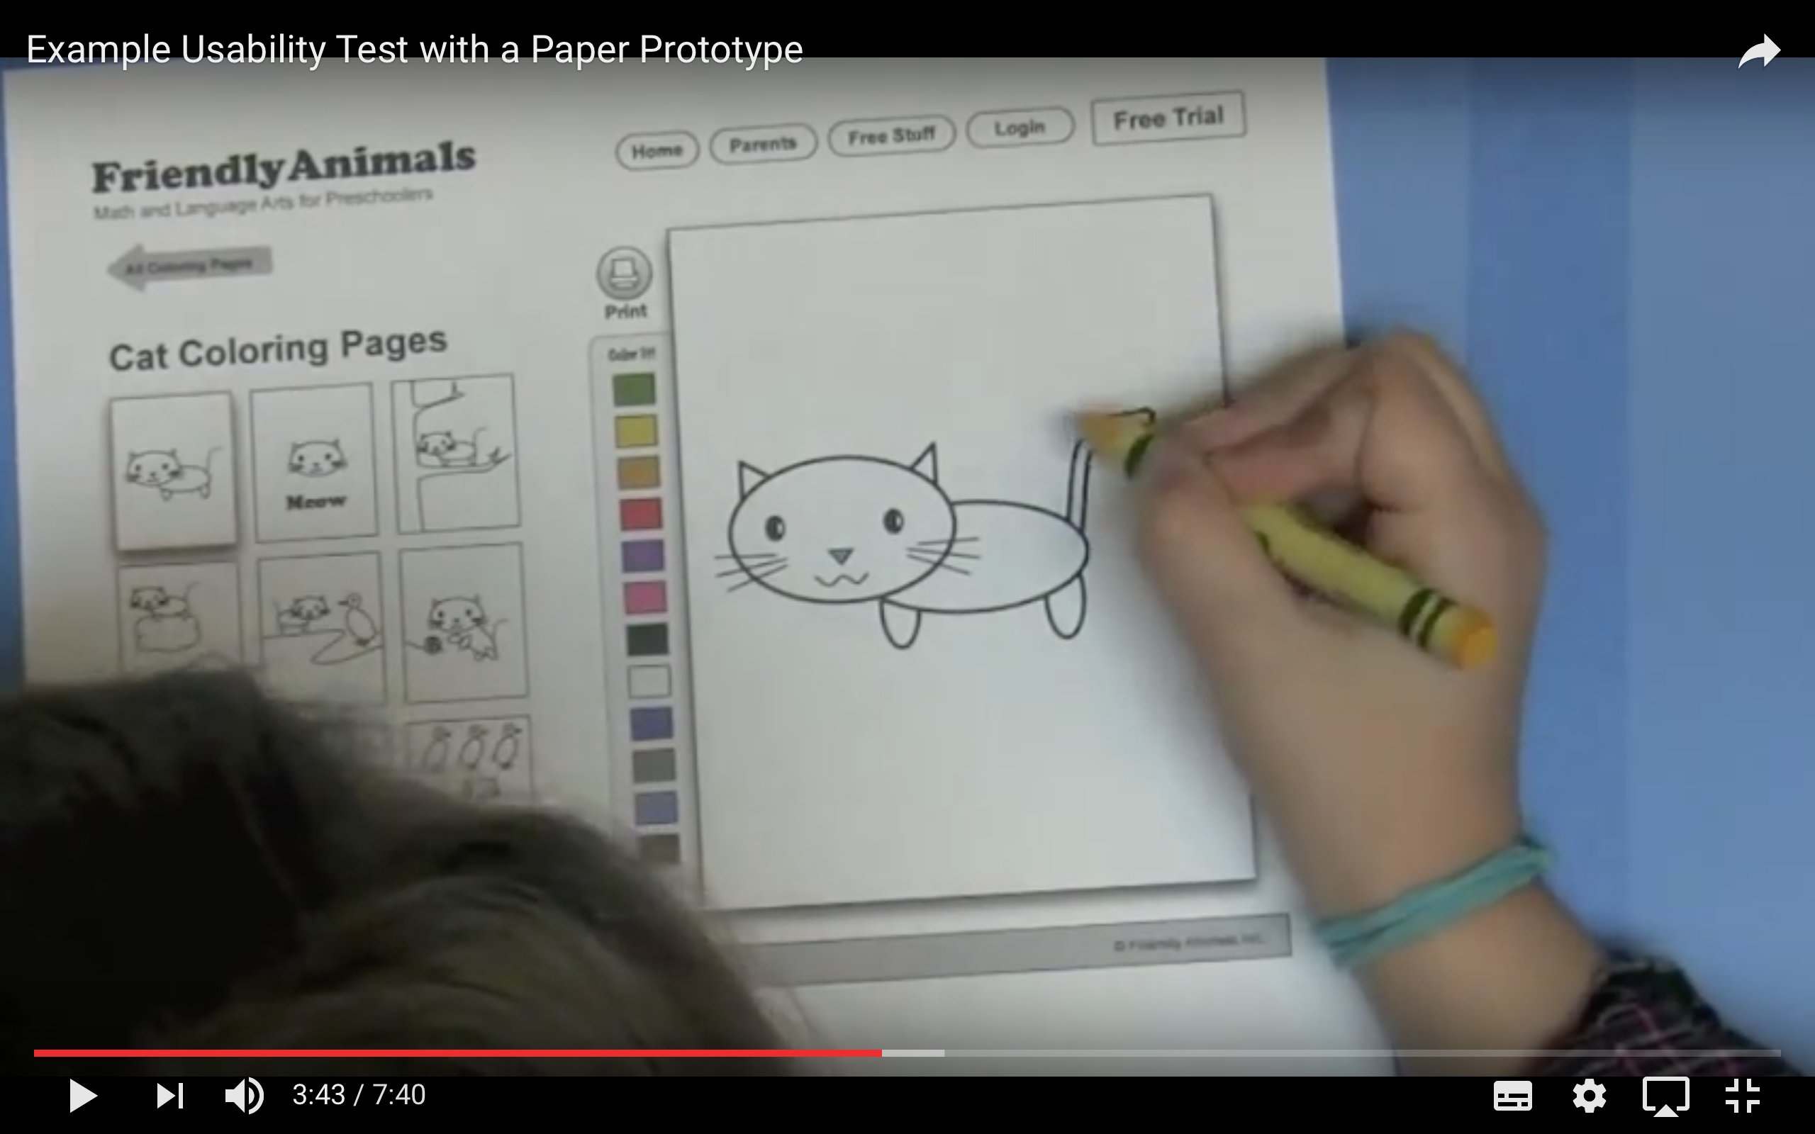
Video Break

Slide 41
What you CAN learn from a prototype
Conceptual model
Do users understand your websites & features?
Functionality
Does your website achieve user’s goal?
Terminology
Do users understand labels?
Task flow
Can users easily find their way around?

Slide 42
What you CANNOT learn from a prototype
Look
Color, font, whitespace
Feel
Efficiency
Response time
Depends on human computer

Slide 43
Group Activity 4 [5 min]
Prototype Test
Choose one user from your team
Pair up with another team
Conduct prototype test with the user from the opposite team

Slide 44
Wrap-up
Keep three usability issues in mind
Keep discussing about the website design with your teammates
Consider design guidelines
Try prototype testing before implementing your website
This material is a derivative of MIT's 6.813/6.831 reading material, used under CC BY-SA 4.0. This work is licensed under CC BY-SA 4.0.

